Slide 1
Loan prediction
CAPSTONE PROJECT
Presented By:
Karthick Raja . R
9513- Jayaraj Annapckiam CSI College of Engineerig
B.E Mechanical Engineering.

Slide 2
OUTLINE
Problem Statement
Proposed System/Solution
System Development Approach
Algorithm & Deployment
Result
Conclusion
Future Scope
References

Slide 3
Problem Statement
The loan prediction problem involves predicting whether a loan applicant will default on their loan or not based on various factors such as their credit history, income, loan amount, loan term, employment status, and so on. It's a classic problem in the domain of credit risk assessment and financial analytics.

Slide 4
Proposed Solution
Data Collection: Gather historical loan data including features such as applicant income, credit history, loan amount, loan term, employment status, etc. This dataset will serve as your training data.
Data Preprocessing: Clean the data by handling missing values, encoding categorical variables, and scaling numerical features if necessary. You may also perform feature engineering to create new features that could improve prediction accuracy.
Exploratory Data Analysis (EDA): Analyze the data to understand patterns, correlations, and distributions. EDA helps in identifying important features and potential relationships between variables.
Feature Selection: Use techniques like correlation analysis, feature importance from machine learning models, or domain knowledge to select the most relevant features for prediction.
Model Selection: Choose appropriate machine learning algorithms for classification tasks such as Logistic Regression, Random Forest, Gradient Boosting, or Support Vector Machines (SVM). Consider ensemble methods for improved performance.
Risk Assessment: Use the trained model to predict loan defaults for new loan applications. Set a threshold based on business requirements to classify applicants as high or low risk.
Feedback Loop: Collect feedback on model predictions and performance from loan officers or users. Incorporate this feedback into model retraining and improvement cycles.

Slide 5
System Approach
Define Objectives: Clearly outline the goals of the loan prediction system. Determine what you want to achieve, such as minimizing default risk, optimizing loan approval processes, or improving decision-making for loan officers.
Exploratory Data Analysis (EDA): Perform exploratory analysis to understand the distribution of features, identify correlations, detect patterns, and gain insights into the dataset. Visualization techniques like histograms, scatter plots, and correlation matrices can be useful here.
Feature Engineering: Create new features or transform existing ones that might improve model performance. For example, derive features like debt-to-income ratio, loan-to-income ratio, or create bins for continuous variables.
Split Data: Split the dataset into training, validation, and test sets. The training set is used for model training, the validation set for hyperparameter tuning and model selection, and the test set for final evaluation.
Monitoring and Maintenance: Continuously monitor the model's performance in production to ensure it remains accurate and reliable. Collect feedback from loan officers or users and retrain/update the model periodically to adapt to changing trends or data drift.
Compliance and Ethics: Ensure that the loan prediction system complies with legal regulations and ethical guidelines regarding data privacy, fairness, and transparency. Implement measures to prevent bias and discrimination in loan decisions.

Slide 6
Algorithm & Deployment
Algorithm Selection
Logistic Regression:
Suitable for binary classification tasks.
Interpretable and efficient for smaller datasets.
Assumes linear relationship between features and target variable.
Random Forest:
Ensemble learning method that combines multiple decision trees.
Handles non-linearity and feature interactions well.
Can handle large datasets and is robust to outliers and noise.
Gradient Boosting Machines (GBM):
Builds trees sequentially, each correcting errors of the previous one.
Often provides high predictive accuracy.
Prone to overfitting if hyperparameters are not tuned properly.
Support Vector Machines (SVM):
Effective for binary classification, especially in high-dimensional spaces.
Finds the optimal hyperplane that best separates classes.
May require scaling of features and careful parameter tuning.
Neural Networks:
Deep learning models capable of learning complex patterns.
Requires larger datasets and computational resources.

Slide 7
Deployment
Model Training and Validation:
Train the selected algorithm on historical loan data.
Validate the model's performance using a separate validation dataset or through cross-validation.
Model Serialization:
Serialize the trained model into a format that can be saved and loaded later, such as Pickle for Python models or ONNX for interoperability.
API Development:
Develop an API (Application Programming Interface) to expose the model's prediction functionality. You can use frameworks like Flask or FastAPI for this purpose.
Integration with Production Environment:
Integrate the API into your production environment, such as a web application or backend system.
Ensure security measures are in place to protect sensitive data and API endpoints.
Scalability and Performance:
Optimize the deployed model for scalability and performance, especially if dealing with high request volumes.
Consider using cloud services like AWS Lambda, Google Cloud Functions, or Docker containers for deployment flexibility.
Testing and Monitoring:
Conduct thorough testing to ensure the deployed model functions as expected.
Implement monitoring mechanisms to track model performance, data drift, and potential issues in real-time.

Slide 8
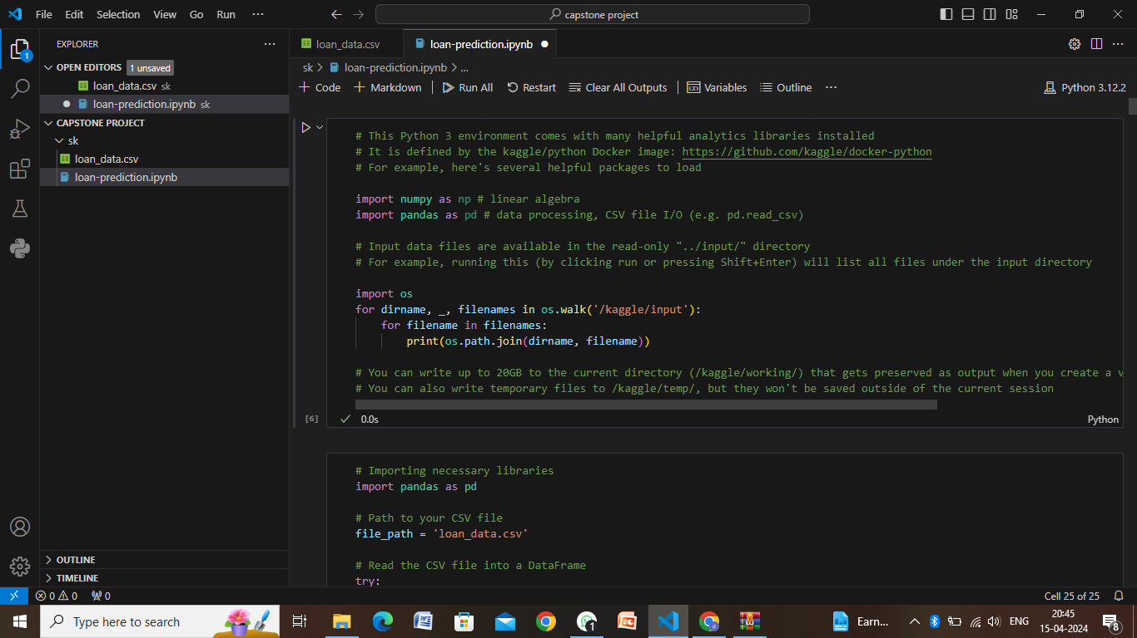
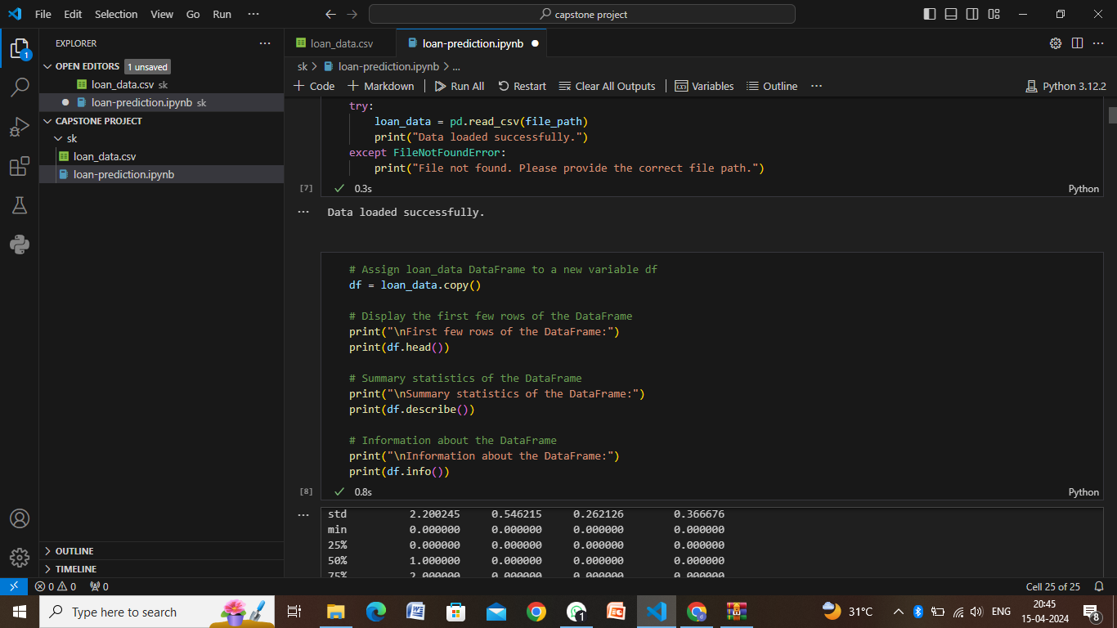
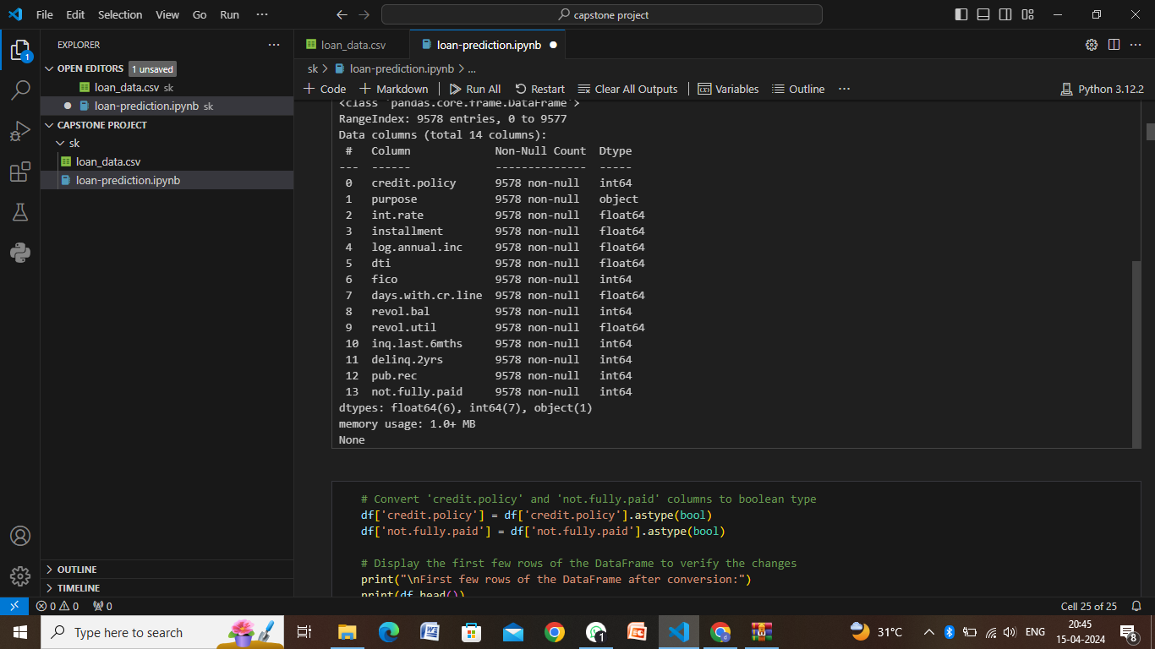
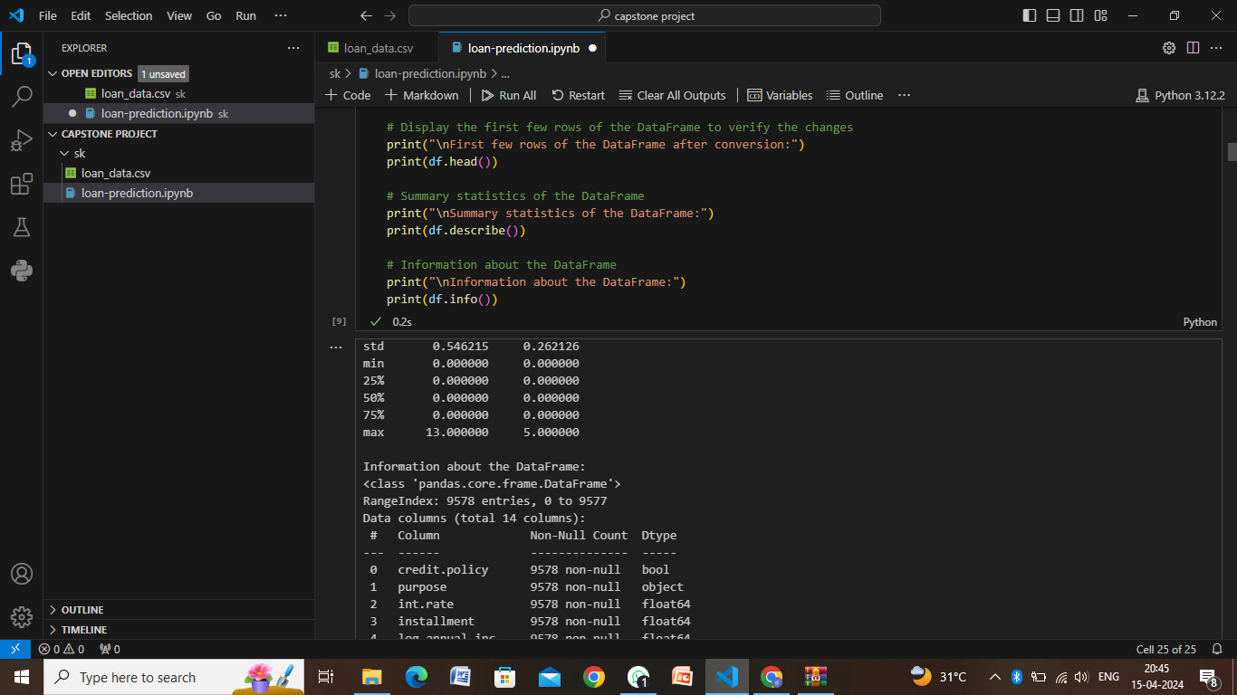
Result

Slide 9
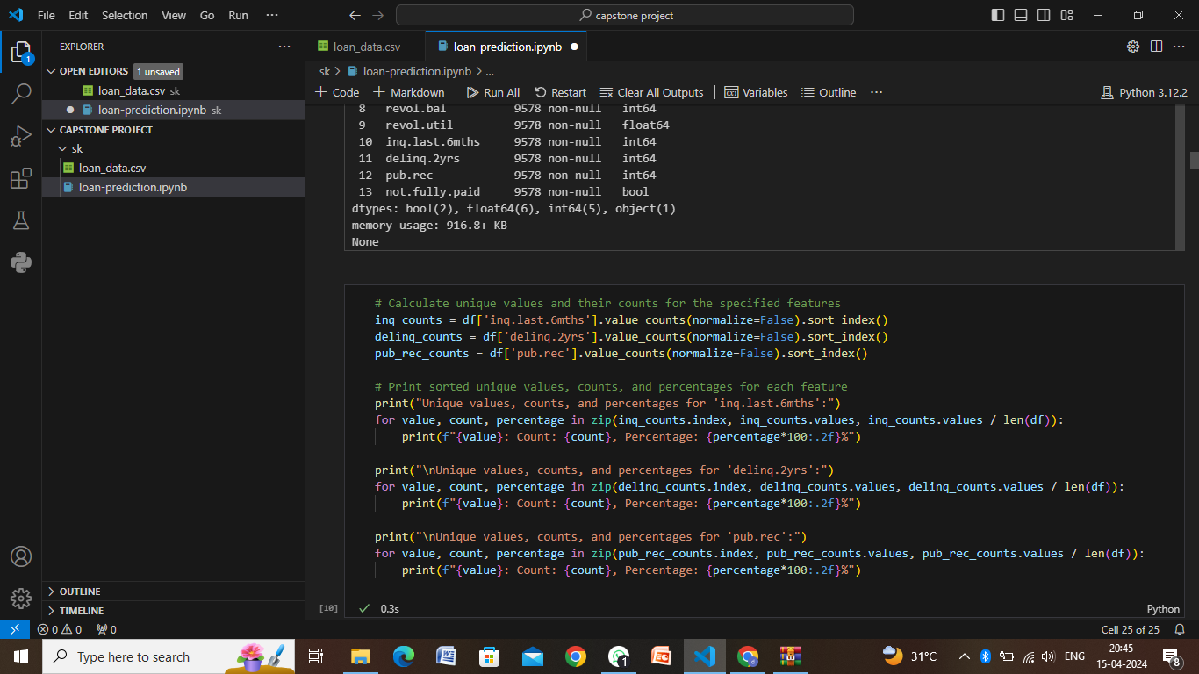
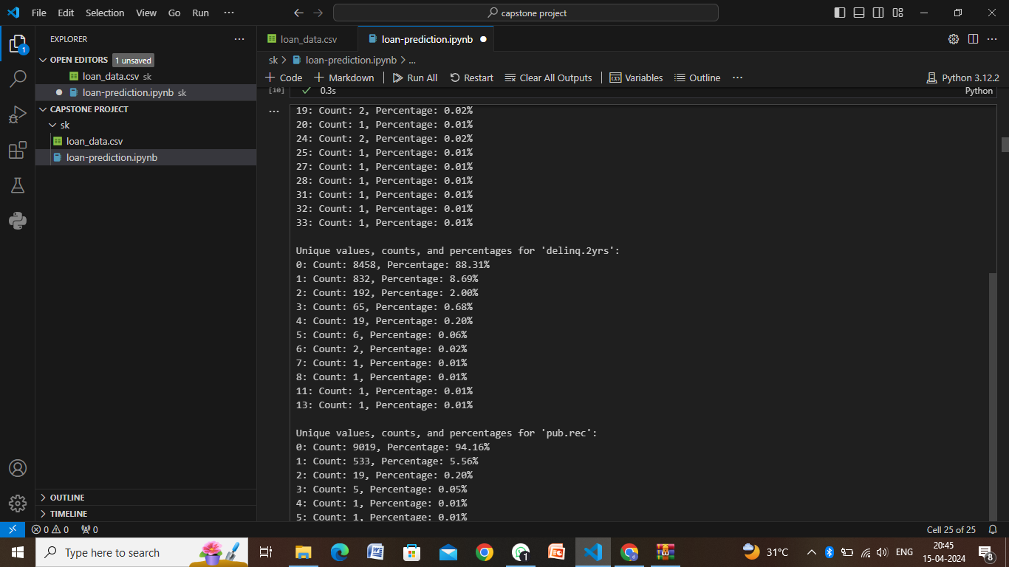
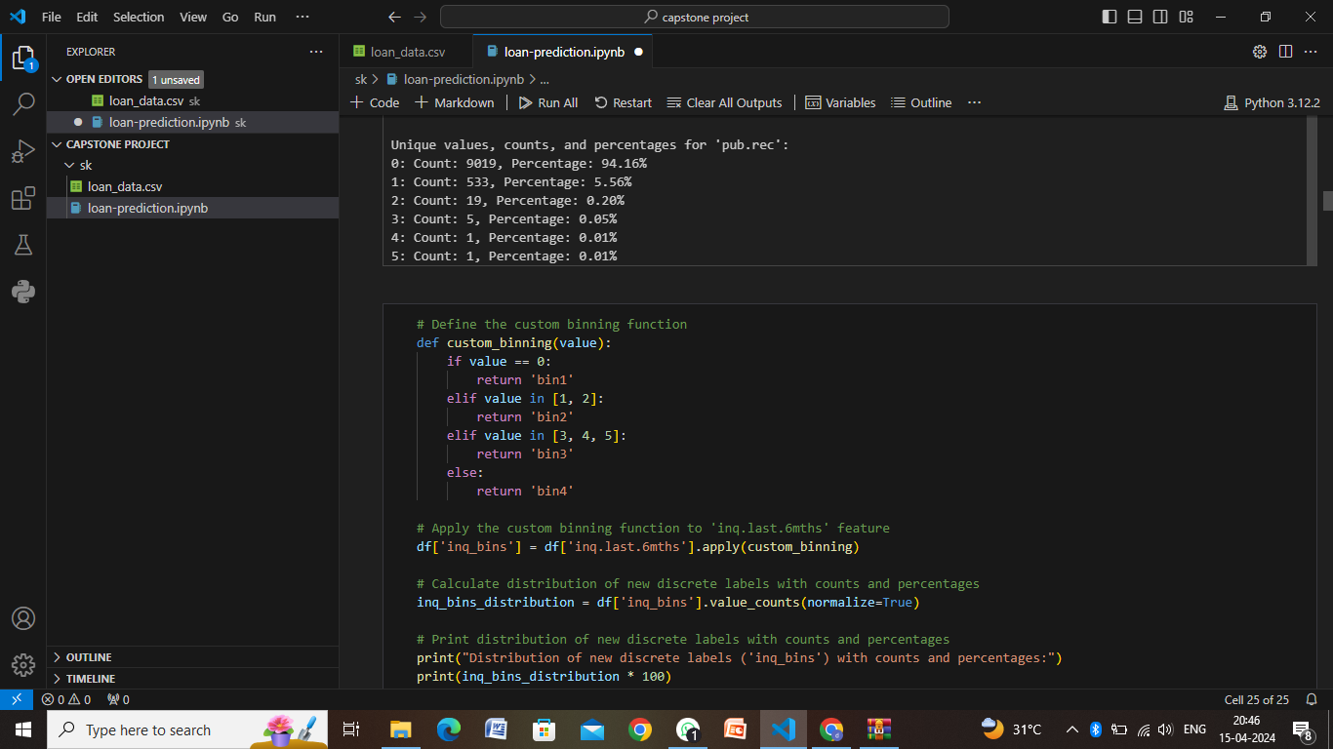
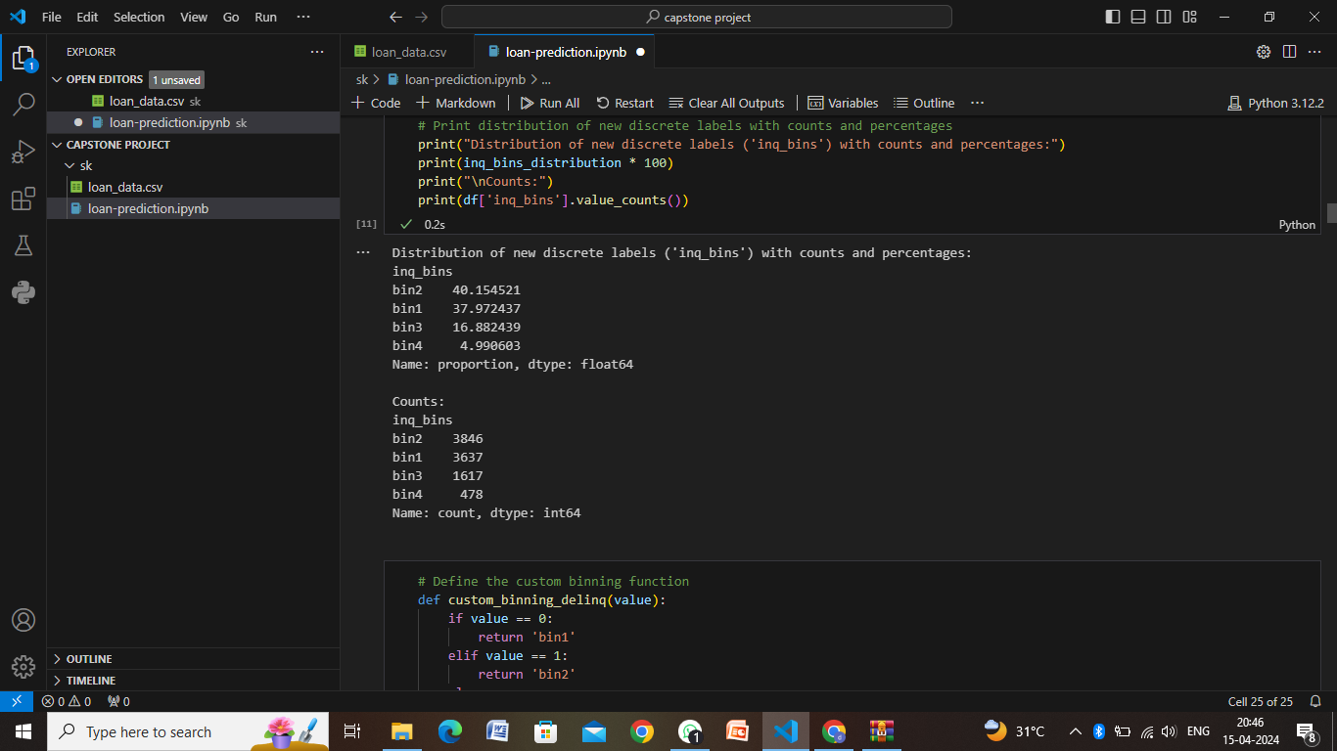

Slide 10
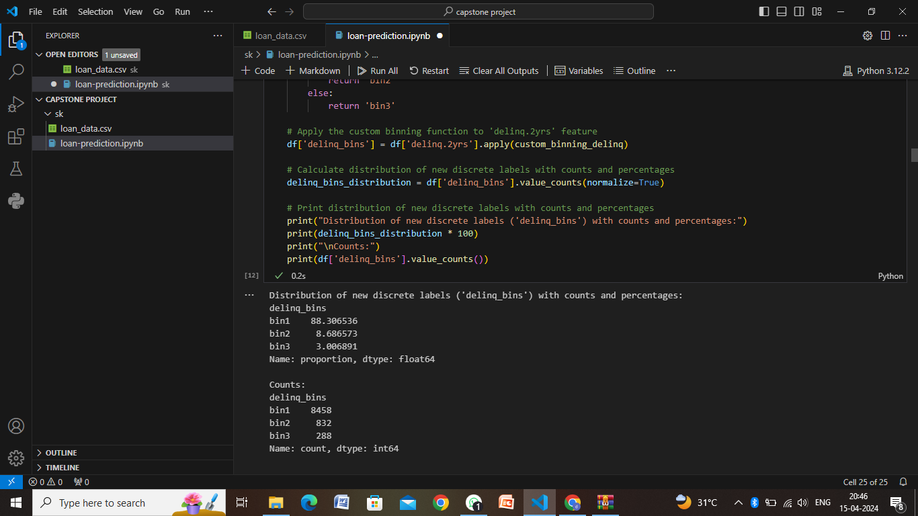
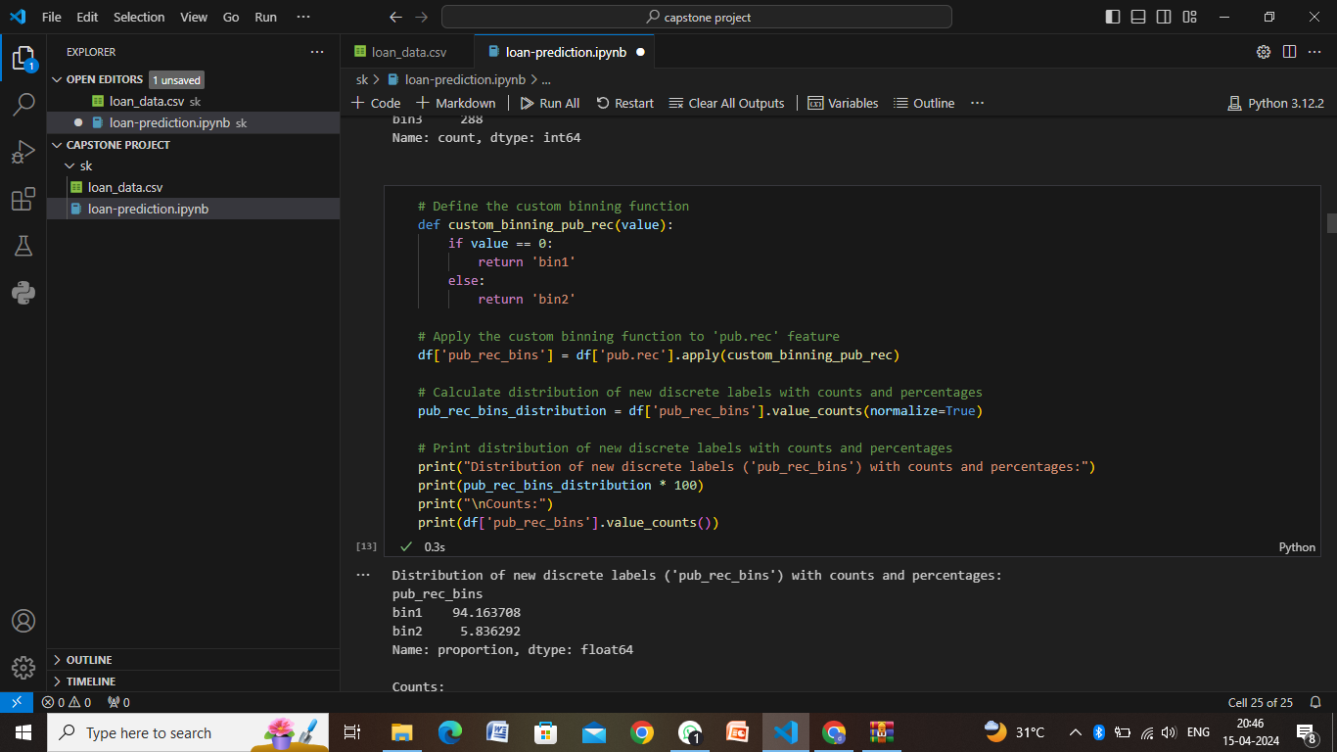
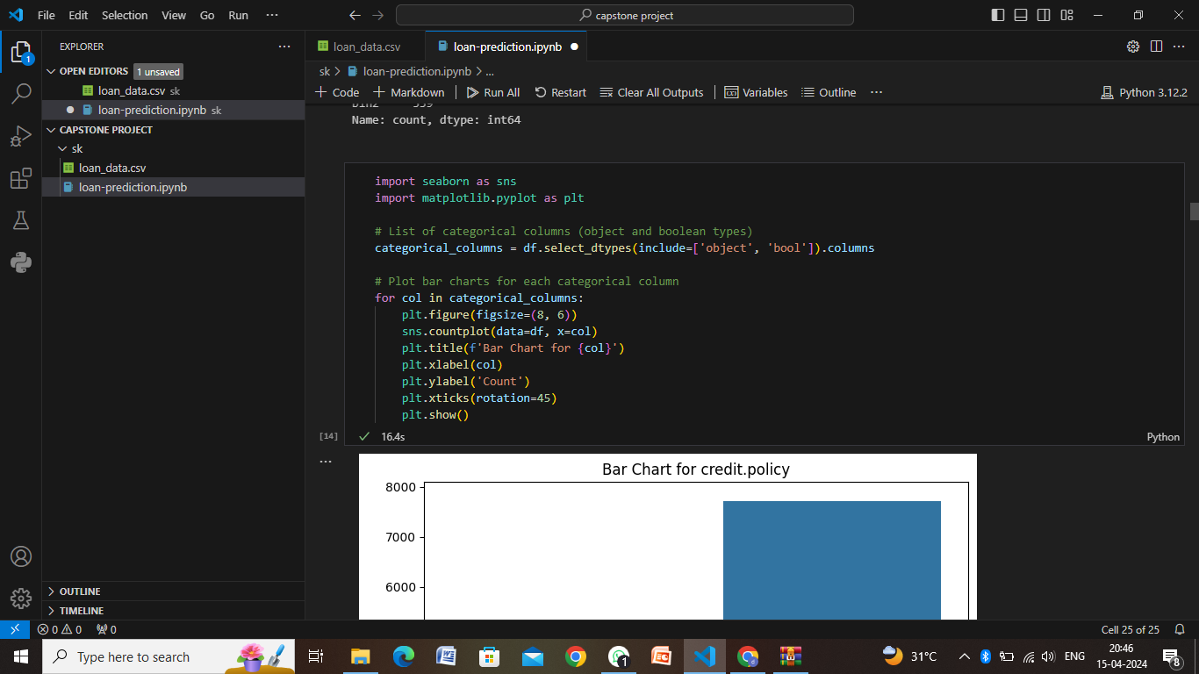
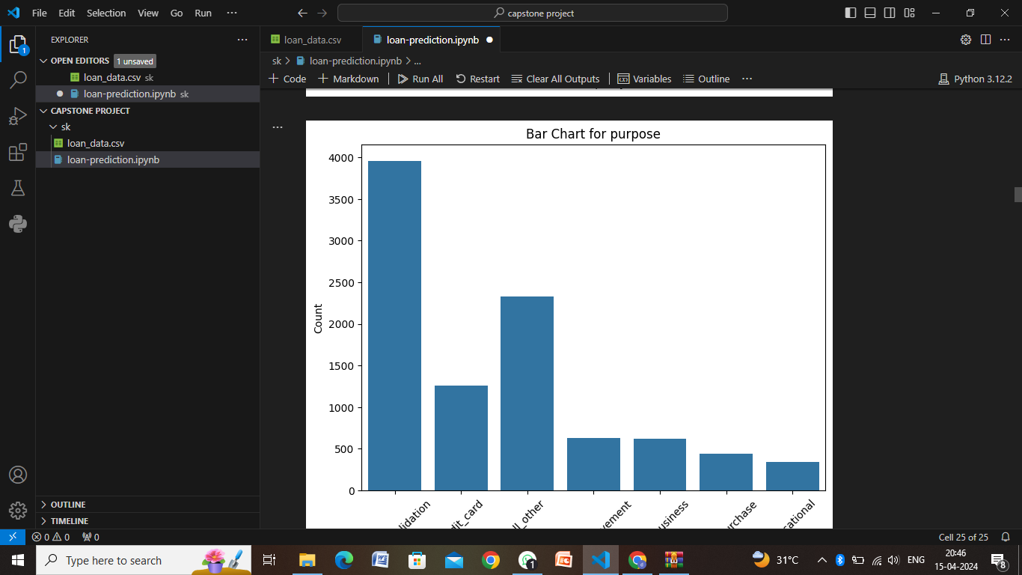

Slide 11
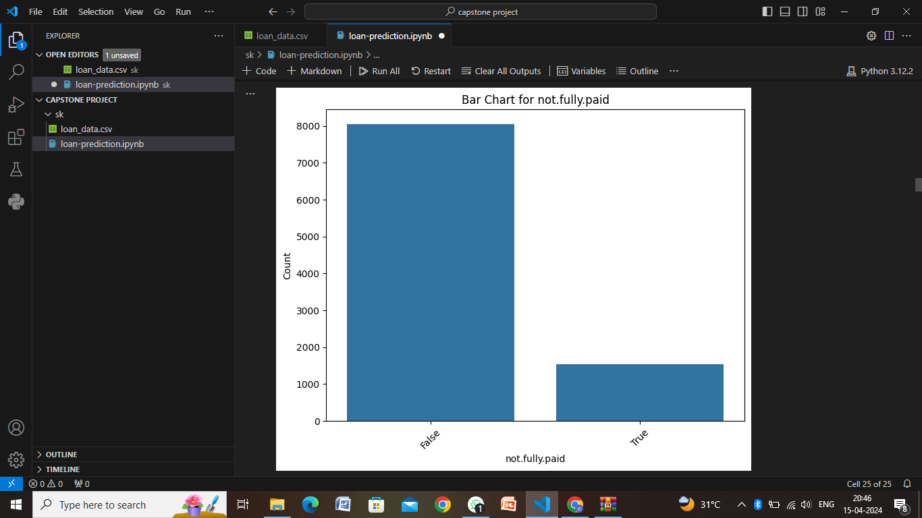
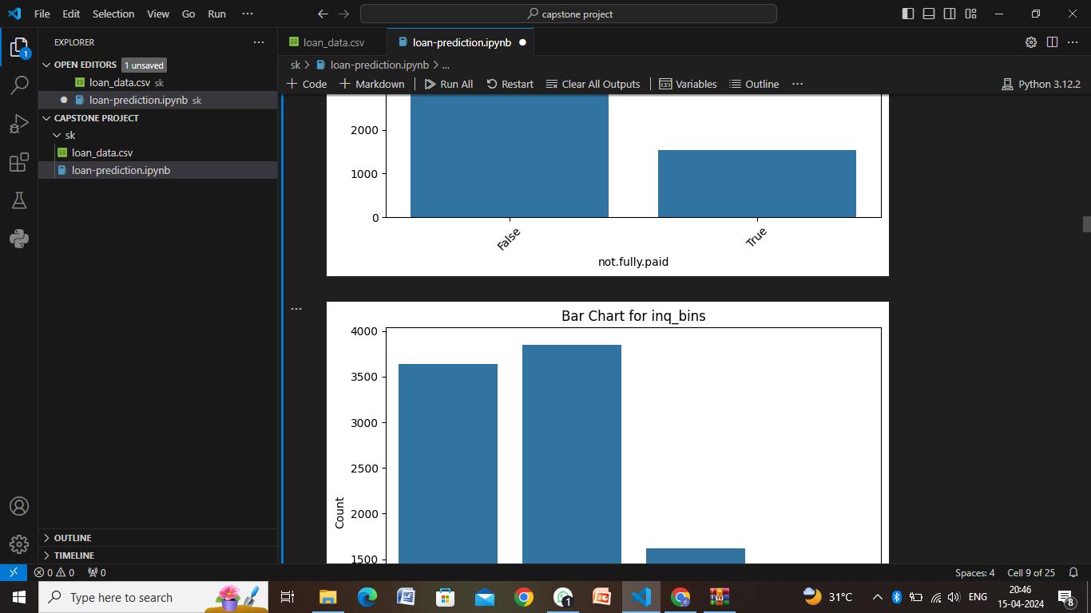
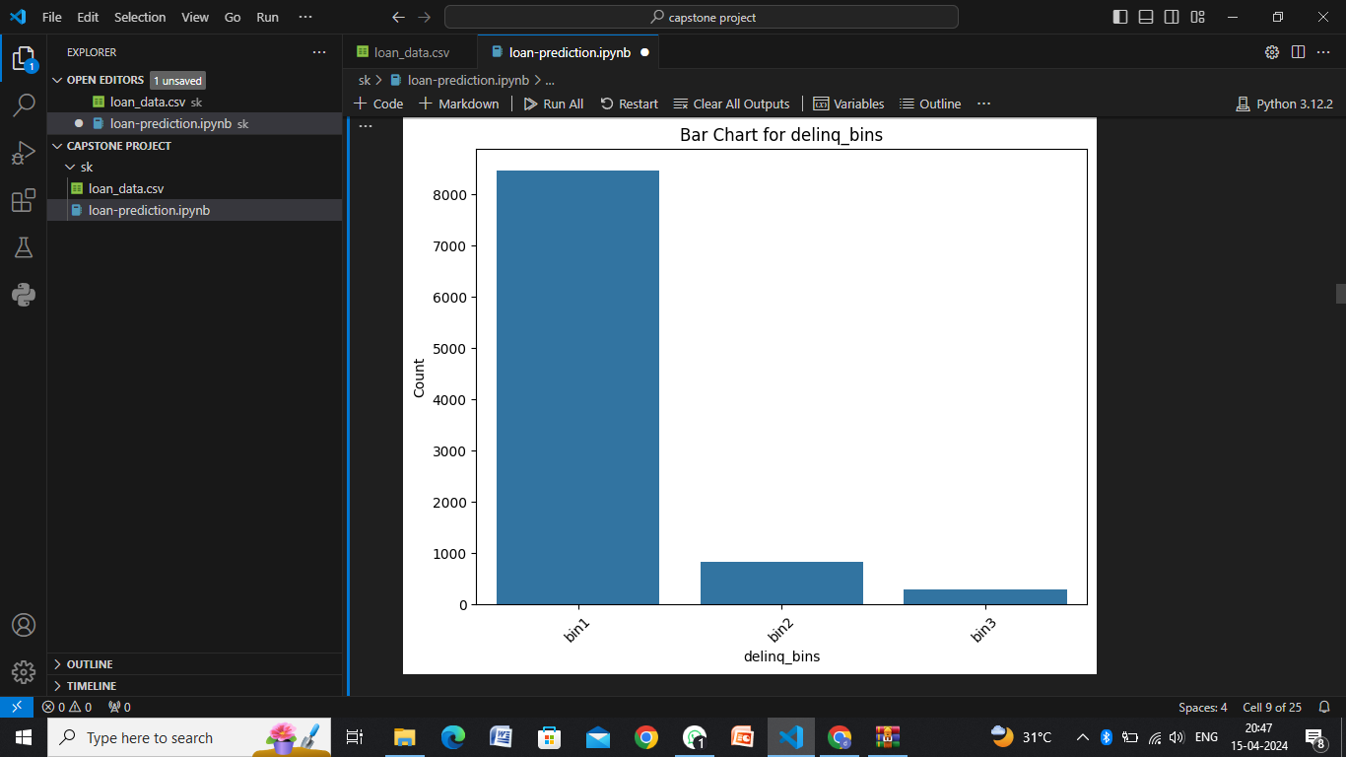
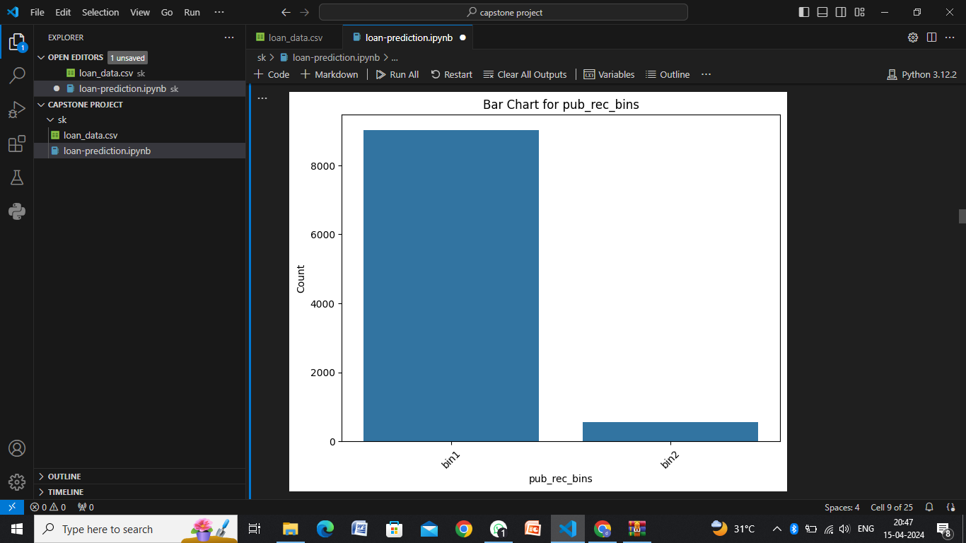

Slide 12
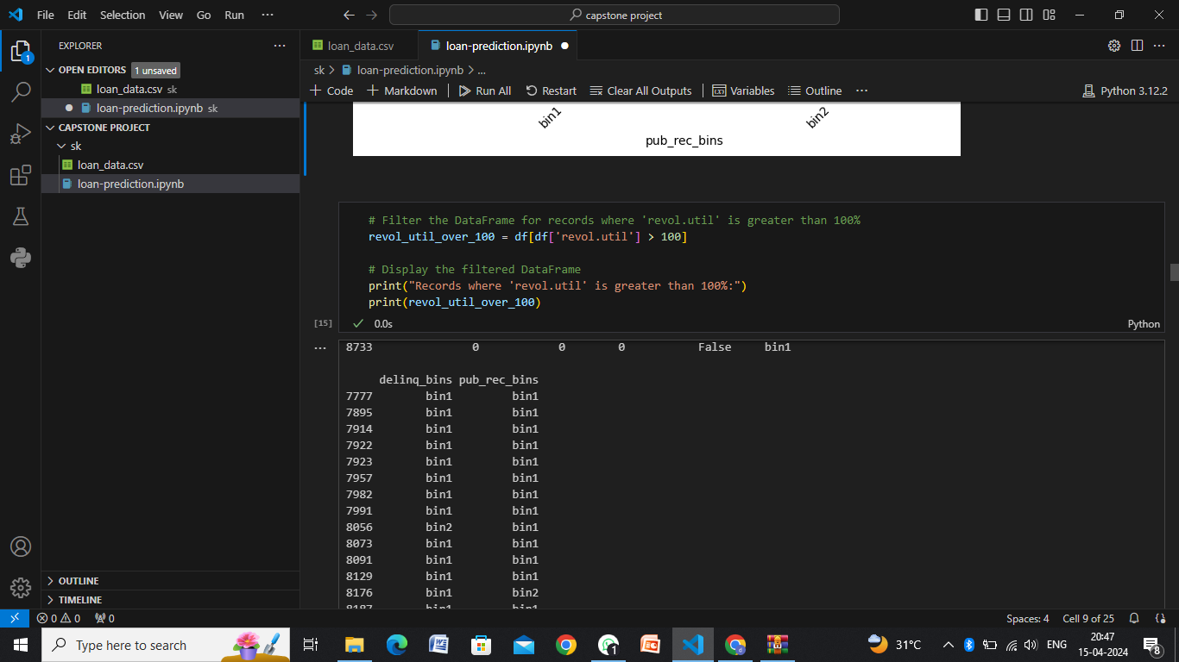
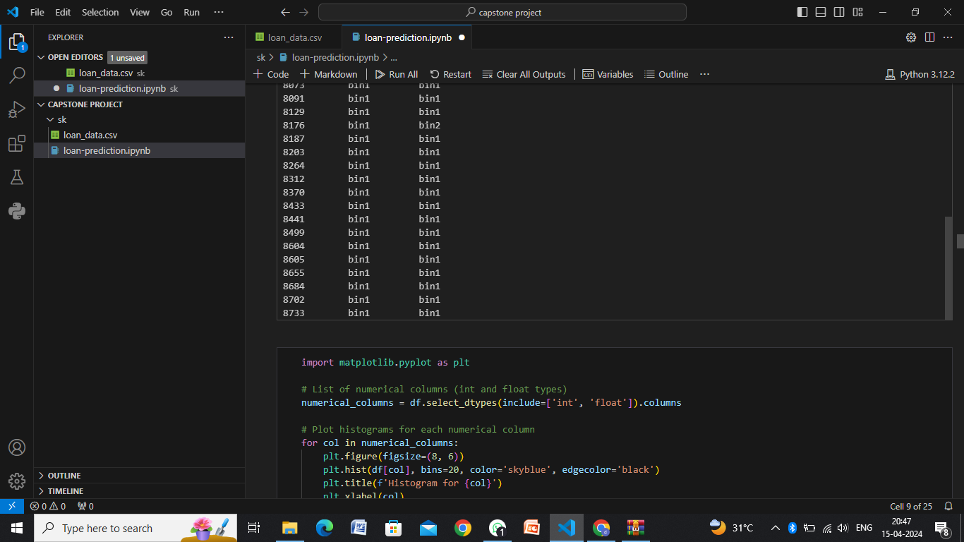
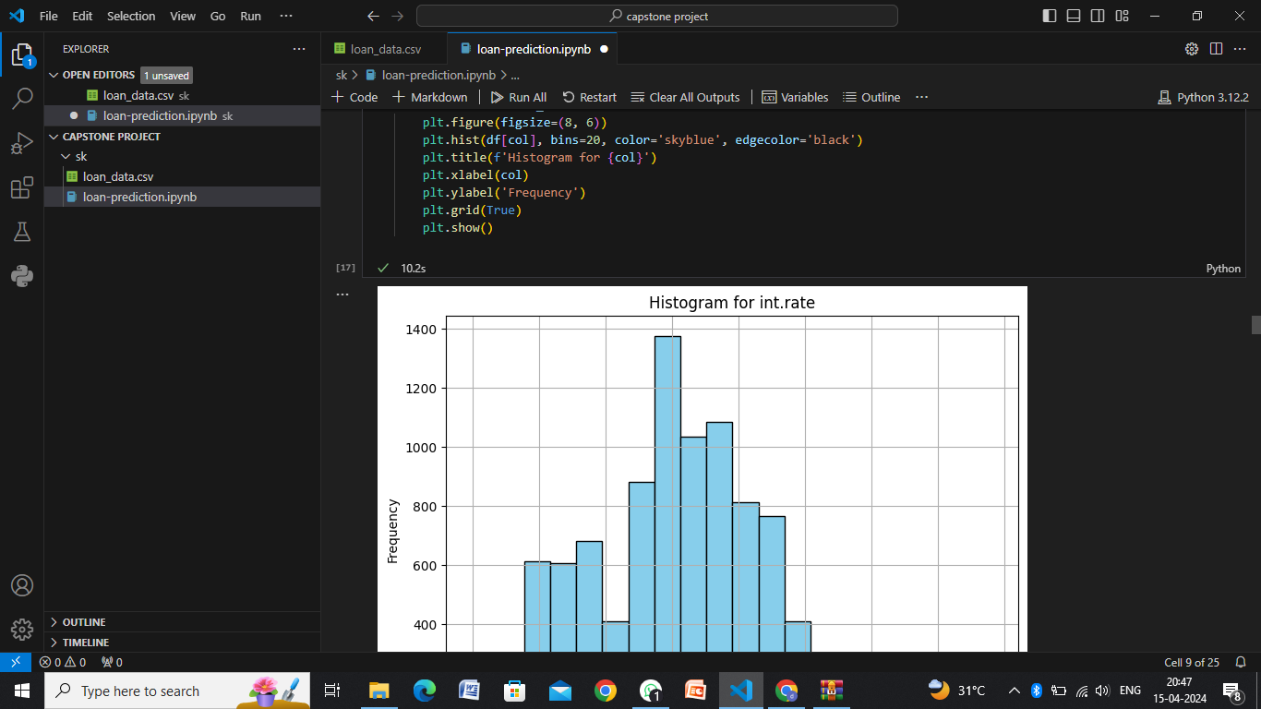
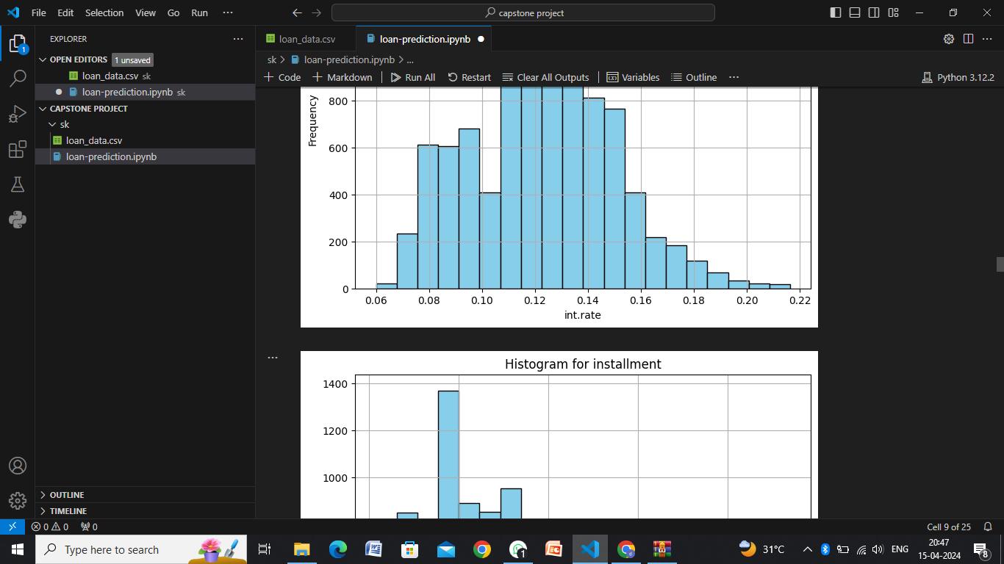

Slide 13
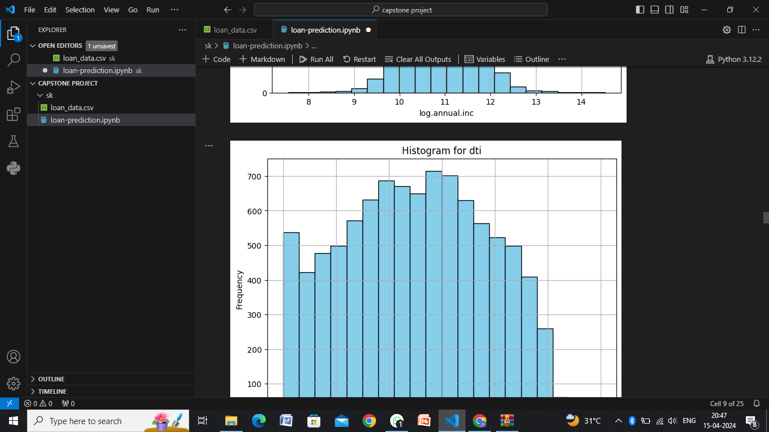
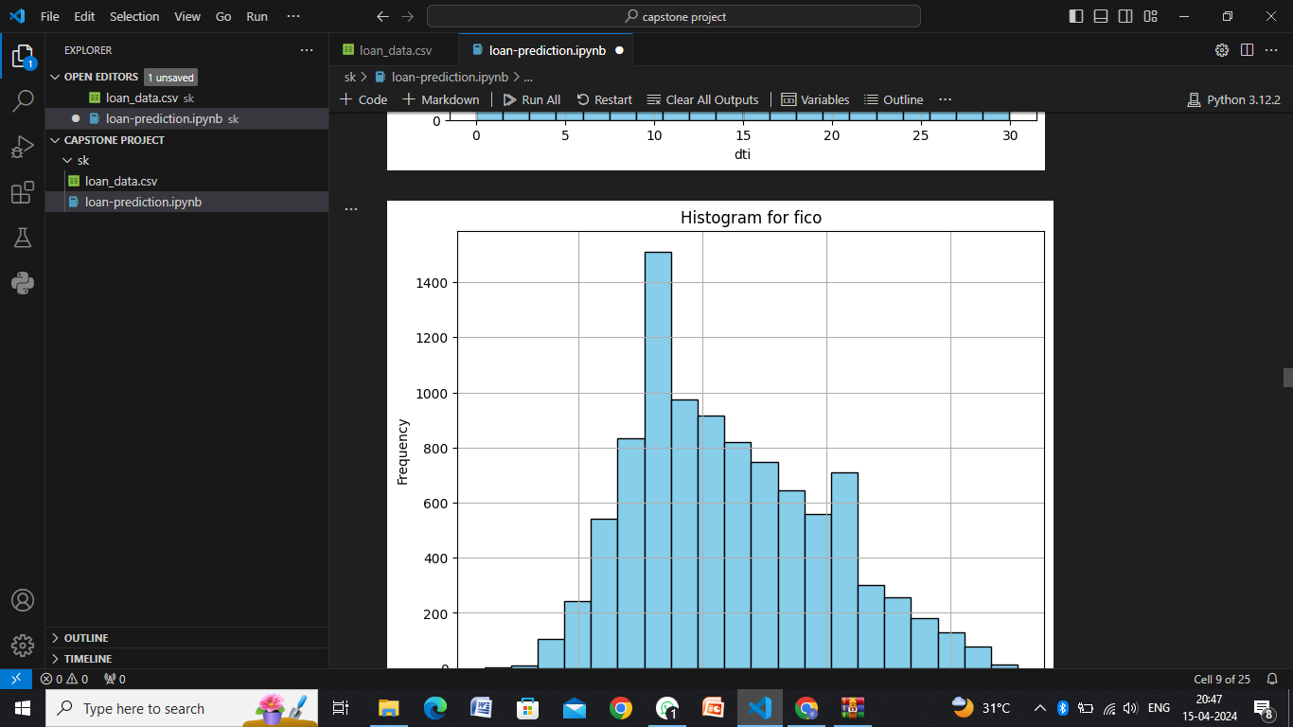
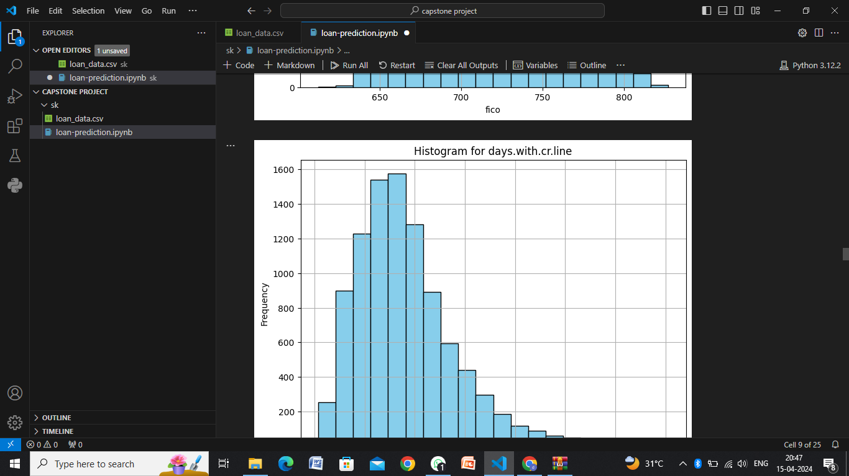
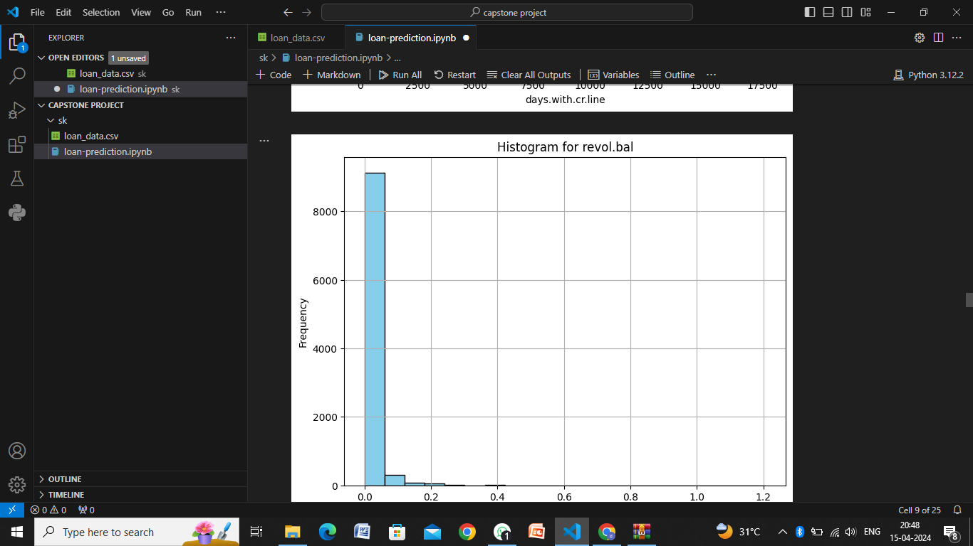
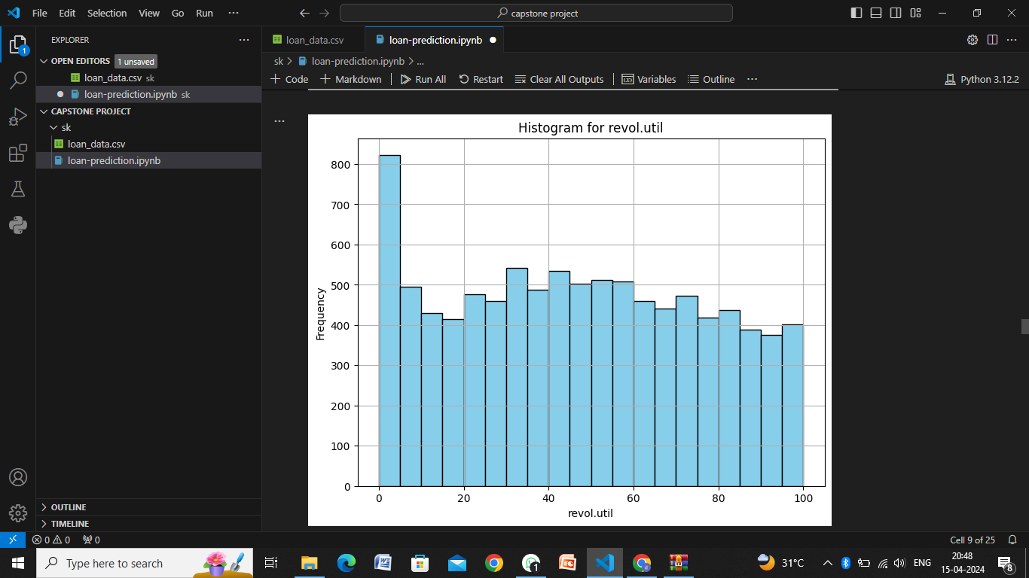
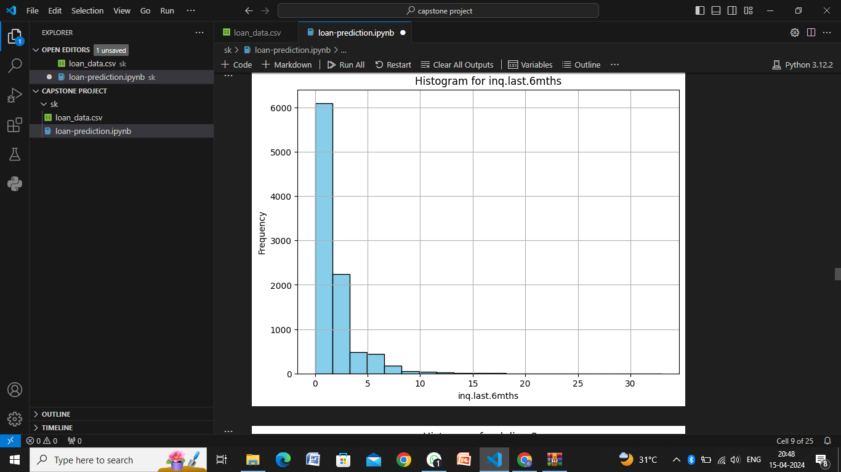

Slide 14
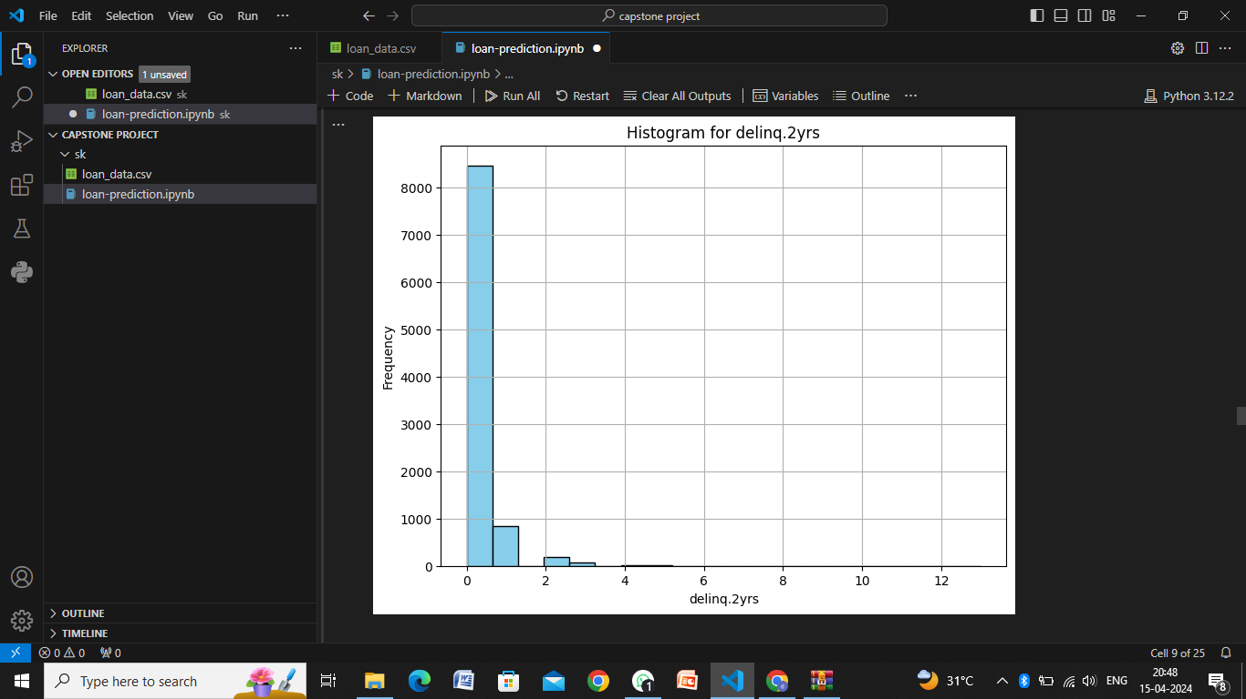

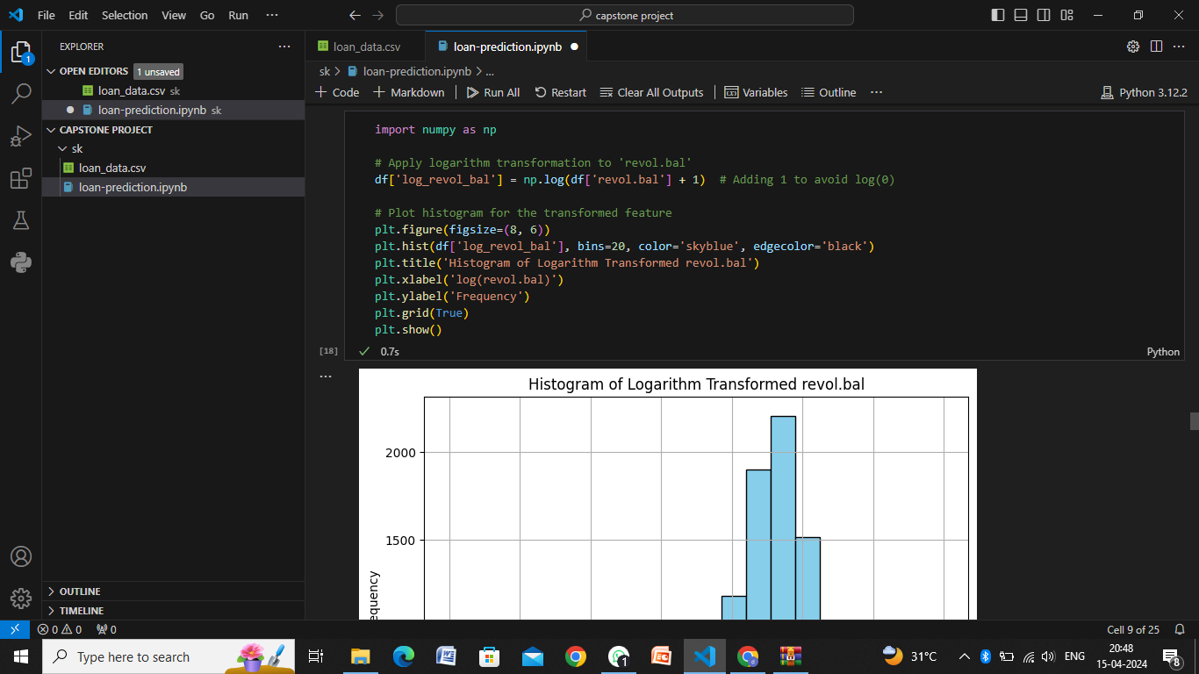
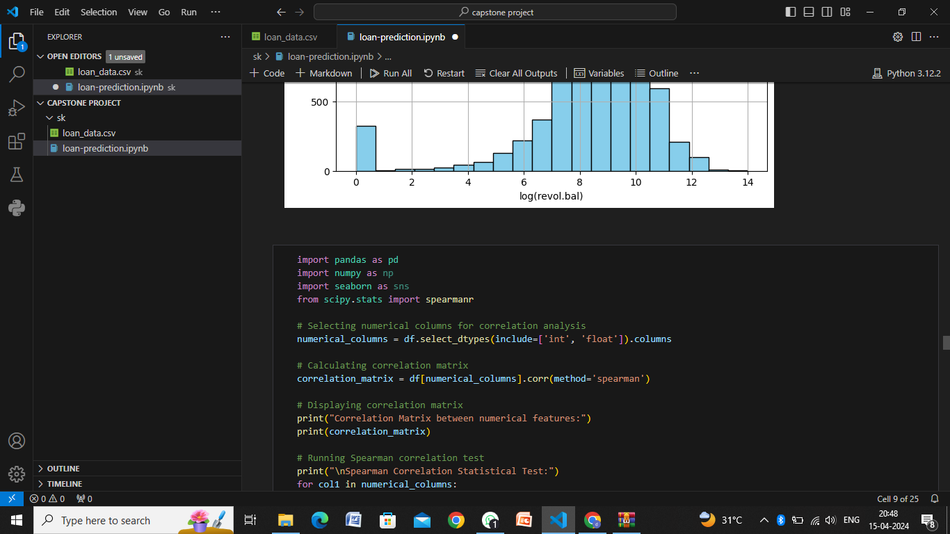
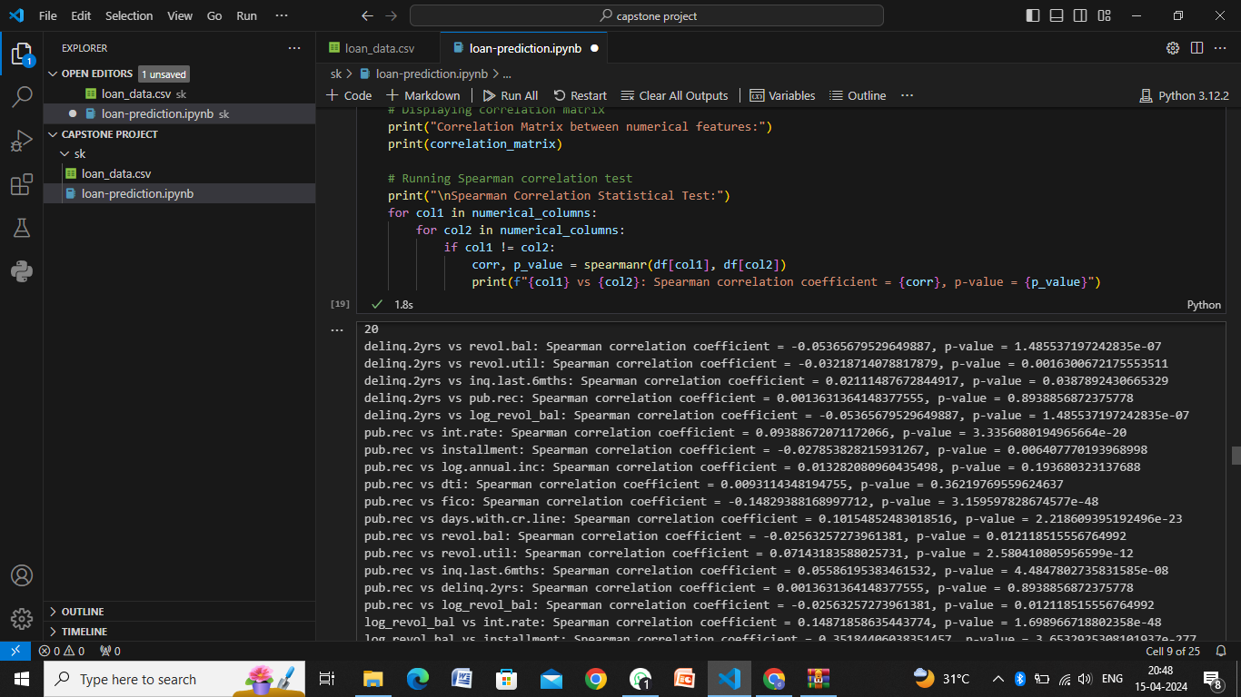
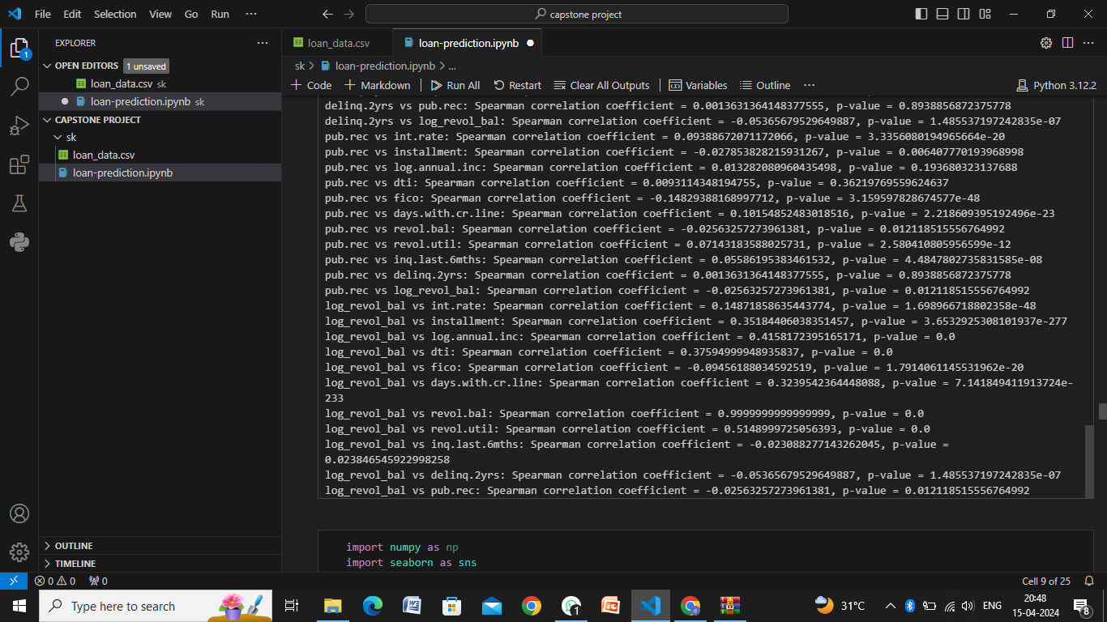

Slide 15
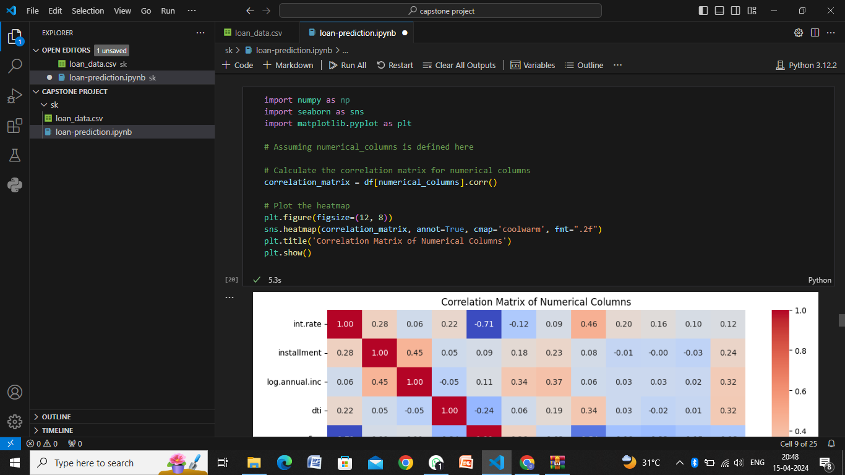
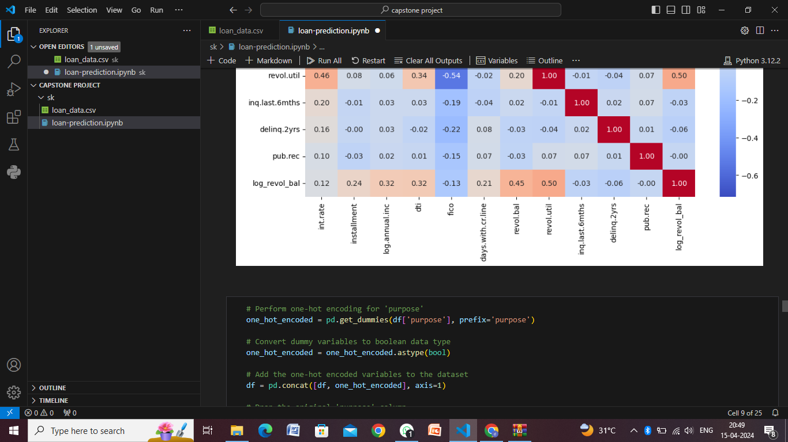

Slide 16
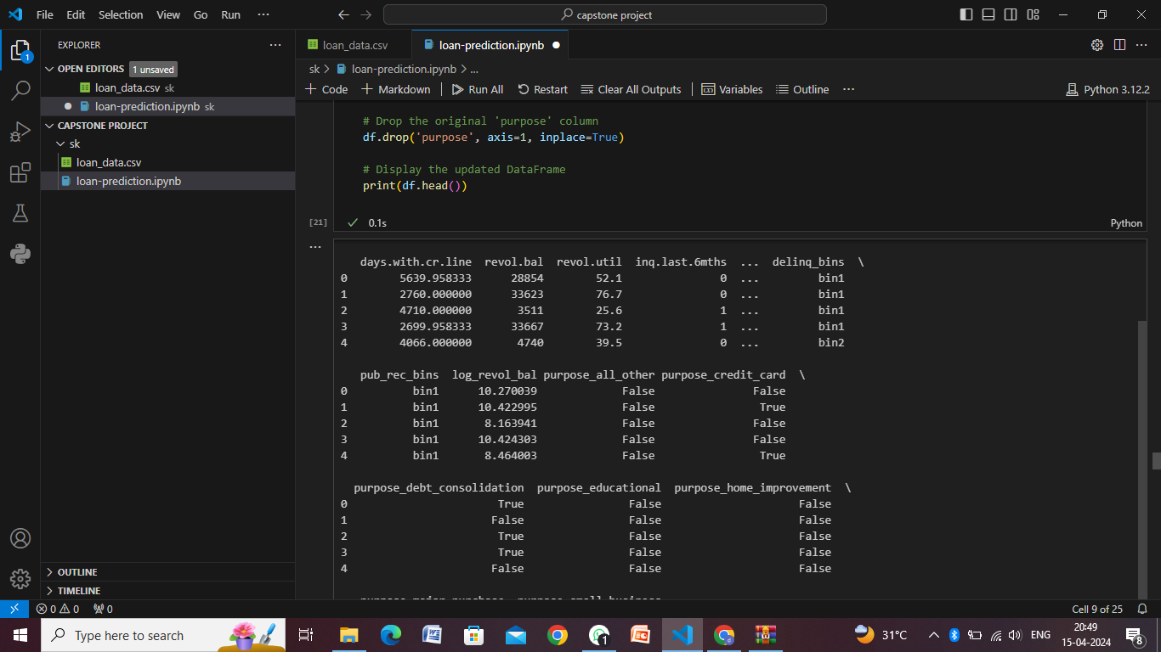
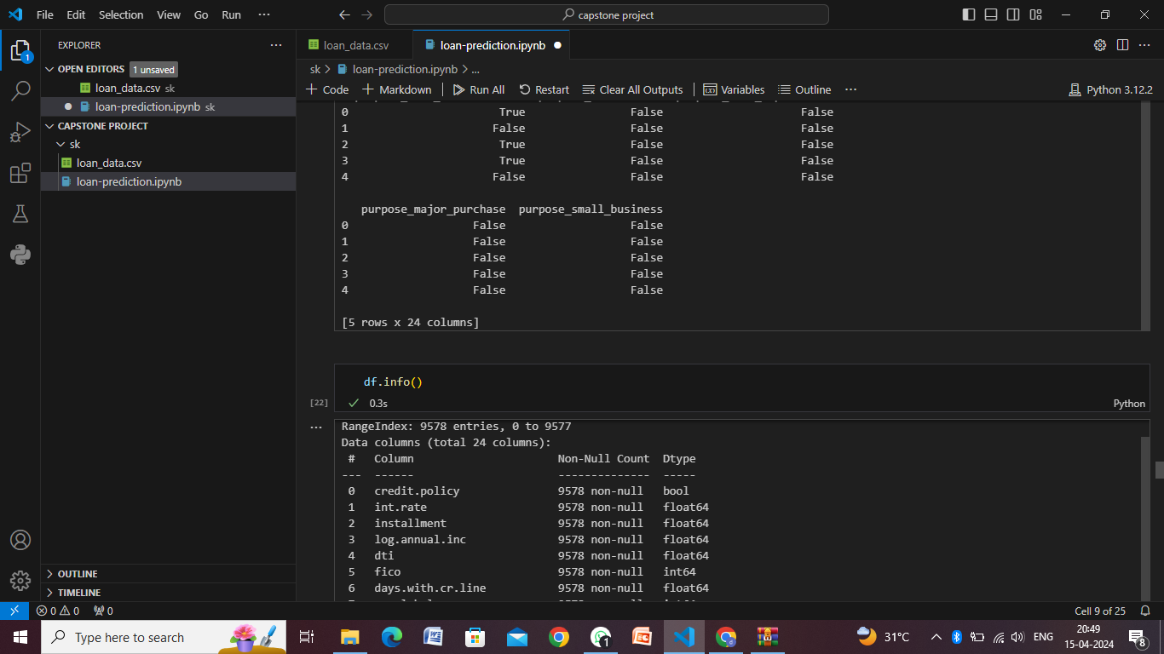
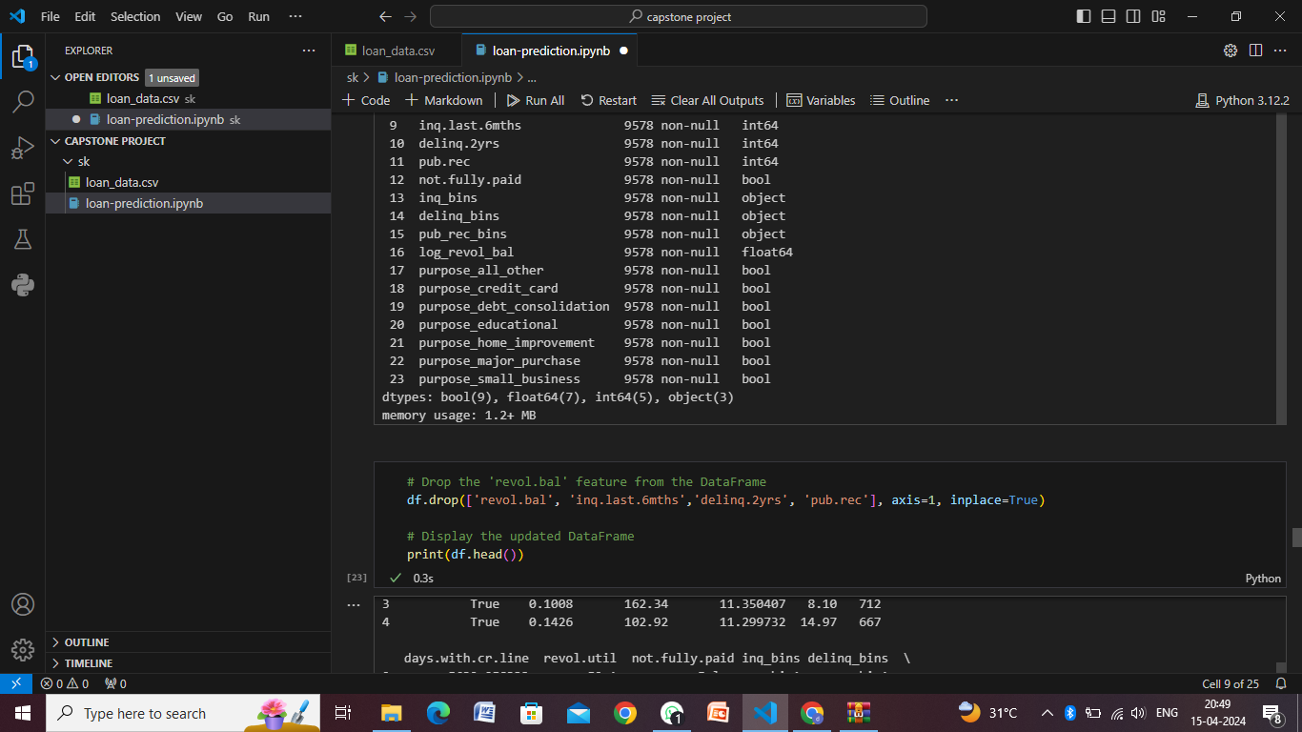
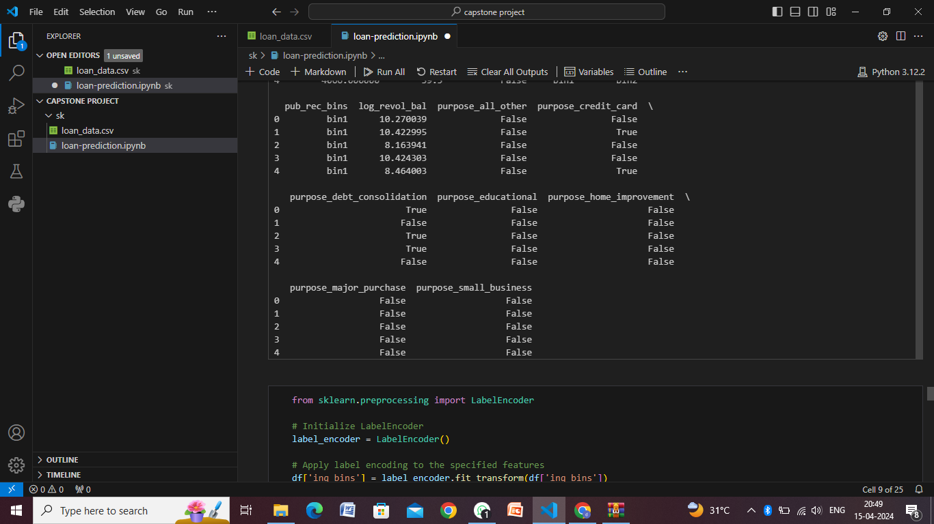
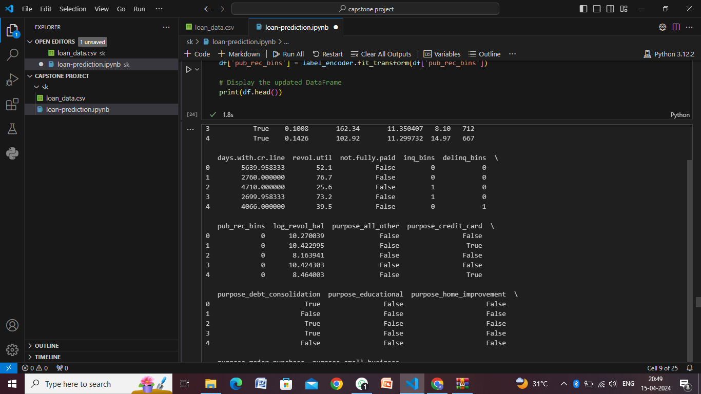
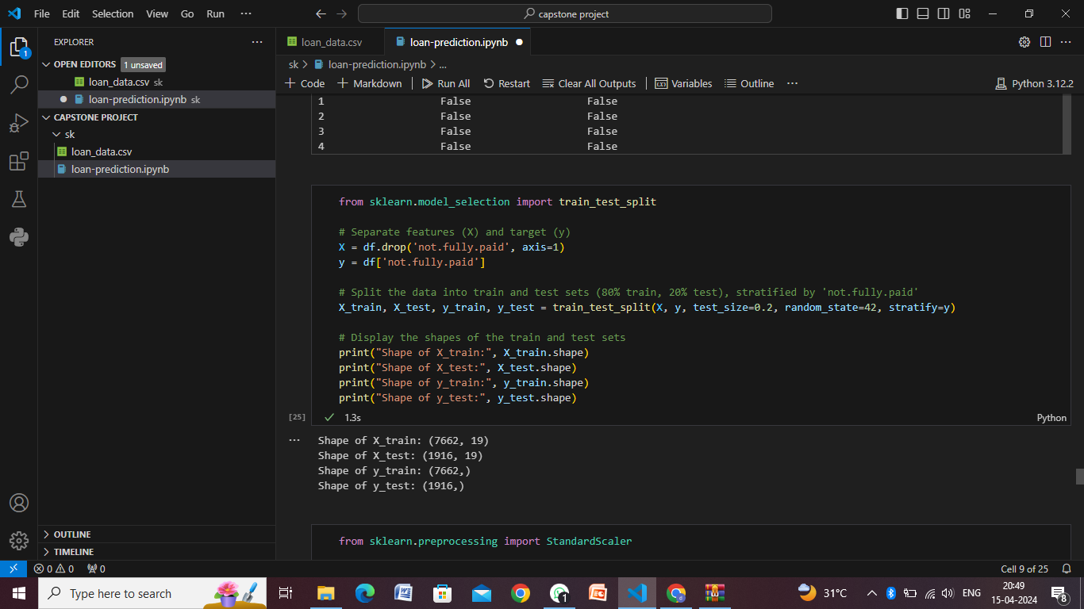

Slide 17
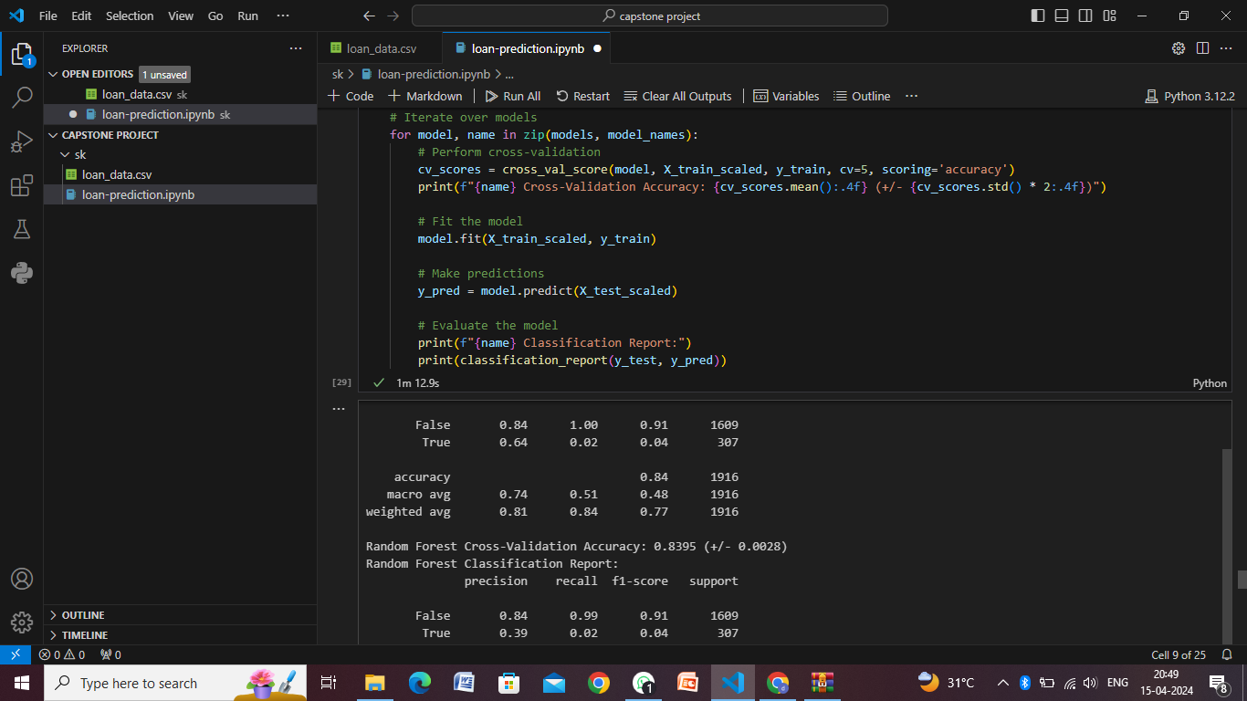
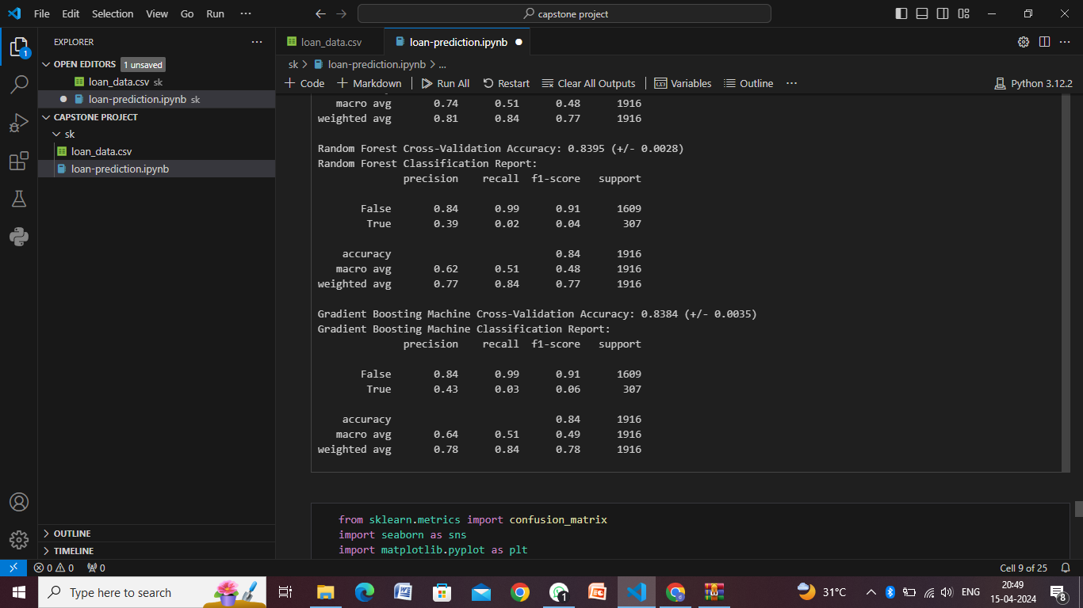
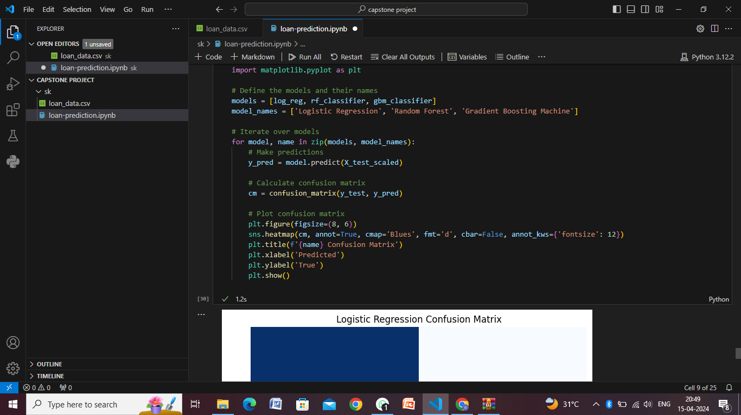
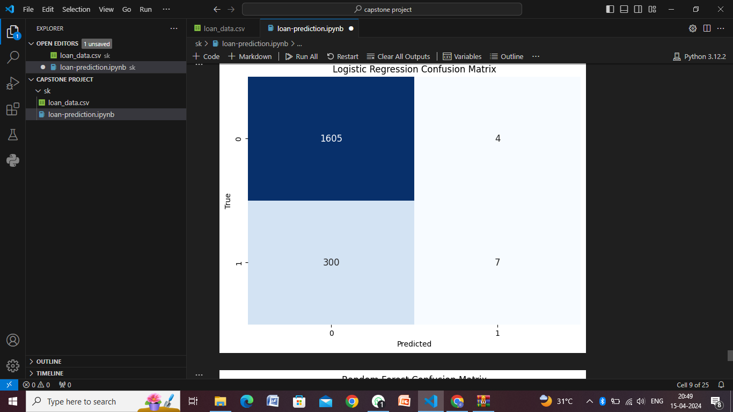
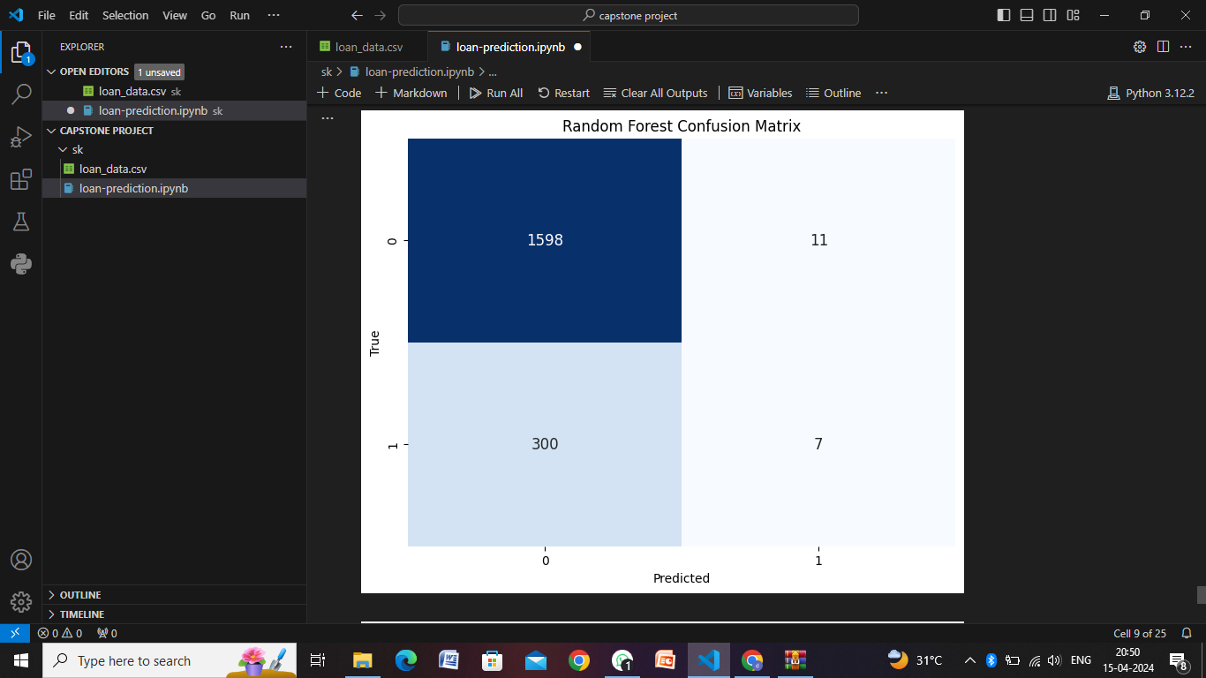
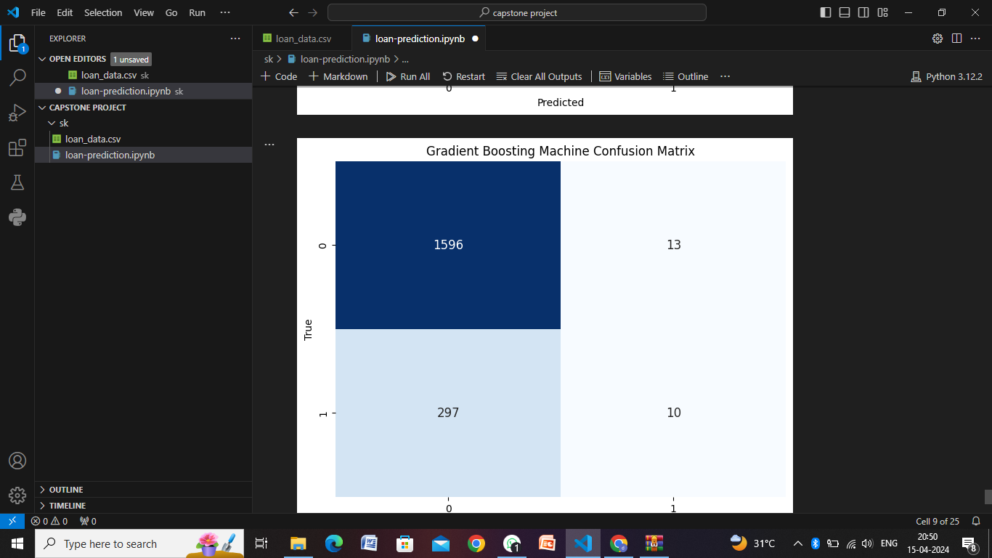

Slide 18
Conclusion
In conclusion, developing a loan prediction system involves a systematic approach encompassing data collection, preprocessing, exploratory analysis, feature engineering, model selection, training, evaluation, deployment, monitoring, and maintenance. By following this structured process, organizations can build robust and reliable systems that aid in minimizing default risk, optimizing loan approval processes, and improving overall decision-making in lending operations.
Key takeaways from the loan prediction process include:
Data Quality Matters
Feature Engineering Adds Value
Model Selection and Evaluation
Deployment and Monitoring
Compliance and Ethics
Documentation and Reporting

Slide 19
Future scope
The future scope of loan prediction systems is exciting and promising, driven by advancements in technology, data analytics, and machine learning. Here are some key areas of potential growth and development:
Advanced Machine Learning Techniques
Alternative Data Sources
Explainable AI (XAI)
Real-time Decision Making
Automated Underwriting and Robotic Process Automation (RPA)
Risk Segmentation and Personalization
Ethical AI and Fairness
Fraud Detection and Prevention

Slide 20
References
UCI Machine Learning Repository: The UCI Machine Learning Repository is a collection of datasets that are commonly used for machine learning research. They may have loan-related datasets that you can use for analysis and modeling.
Research Papers: Academic databases like Google Scholar, IEEE Xplore, and ACM Digital Library contain research papers and studies related to loan prediction, credit risk assessment, and financial analytics. You can search for papers on topics such as "loan default prediction," "credit scoring models," or "machine learning in finance."
Online Courses and Tutorials: Platforms like Coursera, Udemy, and edX offer courses on machine learning, data science, and finance that may include modules or projects related to loan prediction. These courses often provide references, datasets, and practical guidance.
Books on Machine Learning and Finance: Books on machine learning and finance, such as "Hands-On Machine Learning for Algorithmic Trading" by Stefan Jansen or "Machine Learning for Finance" by Stefan J. Daroczi, may cover topics related to loan prediction and credit risk modeling.

Slide 21
THANK YOU

